Slide 1
Man-in-the-Middle Attack (MITM)
A Cybersecurity Threat

Slide 2
Introduction
A Man-in-the-Middle (MITM) attack occurs when an attacker intercepts and potentially alters the communication between two parties without their knowledge.

Slide 3
How Does MITM Work?
1. Interception: The attacker intercepts the communication.
2. Manipulation: The data can be altered or observed.

Slide 4
Techniques Used in MITM
- ARP Spoofing: Impersonating a MAC address to intercept packets.
- DNS Spoofing: Altering DNS responses to redirect traffic.
- Rogue Wi-Fi: Setting up fraudulent Wi-Fi access points.

Slide 5
Impacts of MITM
- Data theft: Sensitive information such as passwords.
- Espionage: Monitoring user activity.
- Data manipulation: Modifying messages or transactions.

Slide 6
Implementation
Ettercap

Slide 7
TCP Session Hijacking
A Critical Network Security Vulnerability

Slide 8
Introduction
TCP Session Hijacking is a type of cyber attack where the attacker takes over an active TCP session between two parties, often pretending to be one of them.
The attacker gains unauthorized access to the session, potentially stealing data or injecting malicious commands.

Slide 9
How Does TCP Session Hijacking Work?
1. Session Sniffing: The attacker monitors the network to capture the session ID.
2. Sequence Prediction: Predicting TCP sequence numbers to inject packets.
3. Session Takeover: Sending created packets to take control of the session.
Requires the attacker to be on the same network or have access to the traffic.

Slide 10
Techniques Used in TCP Session Hijacking
- IP Spoofing: Impersonating the IP address of a trusted client.
- Sequence Number Prediction: Guessing TCP sequence numbers to inject packets.
- Packet Injection: Sending malicious packets to disrupt or control the session.
- Sniffing Tools: Using tools like Wireshark to capture network traffic.

Slide 11
Impacts of TCP Session Hijacking
- Data Theft: Stealing sensitive information during the session.
- Command Execution: Injecting malicious commands.
- Service Disruption: Interrupting legitimate communication.
- Financial Loss: Exploiting online banking sessions or other financial activities.

Slide 12
Reminder:
Man in the Middle (ARP Poisoning)
TCP Session Hijacking !

Slide 13
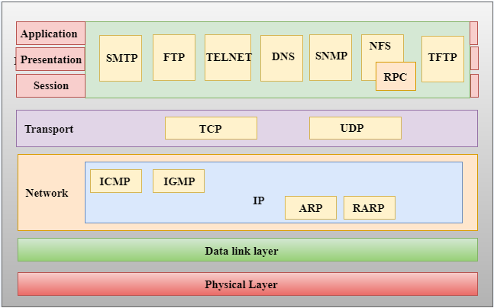
TCP/IP Model
TCP/IP model (Layers/Protocols)

Slide 14
Advanced Insights into UDP Protocol
Understanding, Detecting, and Mitigating UDP-Based Attacks

Slide 15
Introduction to UDP (User Datagram Protocol)
The User Datagram Protocol (UDP) is a fundamental Internet protocol used to send messages (datagrams) to hosts on an IP network.

Slide 16
TCP vs UDP ?

Slide 17
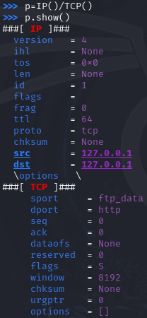
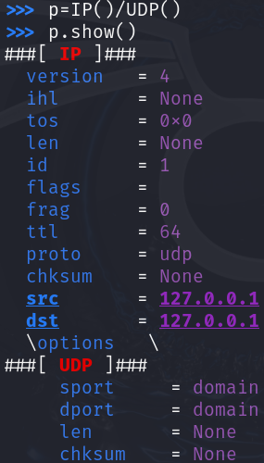
TCP Header vs UDP Header

Slide 18
Checksum
The checksum in the UDP header serves the purpose of error detection. It ensures that the data within the UDP packet has not been corrupted during transmission.

Slide 19
Example of UDP Workflow
Sender: Builds a UDP packet with the destination address and port. Sends the packet to the receiver.
Network: Routes the packet from sender to receiver using the IP layer. Does not provide feedback to the sender if the packet is lost or delayed.
Receiver: Listens on the specified port. Processes the packet upon arrival without expecting a formal acknowledgment.
If no program is receiving packets on this port, the server responds with an ICMP (ping) packet to inform the sender that the destination is unreachable.

Slide 20
Example of UDP Workflow
UDP_Server_Code.py
UDP_Client_Code.py

Slide 21
Transport Layer Protocols
Properties | TCP | UDP
Connections
Reliability & Ordering
ACK
Speed
Broadcast
√
√
√
√
√
Notes:
Reliability: correct order

Slide 22
Transport Layer Protocols Use Cases
Application | TCP | UDP
Web browsing (HTTP/HTTPS)
Email (SMTP/IMAP/POP3)
File Transfer (FTP)
On-demand Video Streaming (Netflix, YouTube)
Live Video Streaming (Twitch, Zoom Live)
Voice over IP (VoIP)
Online Gaming
Instant Messaging (WhatsApp, Telegram)
System Updates (Windows/Linux)
√
√
√
√
√
√
√
√
√

Slide 23
UDP flood?
A UDP flood is a type of denial-of-service attack in which a large number of UDP (User Datagram Protocol) packets are sent to a target server with the aim of overwhelming its processing and response capacity.

Slide 24
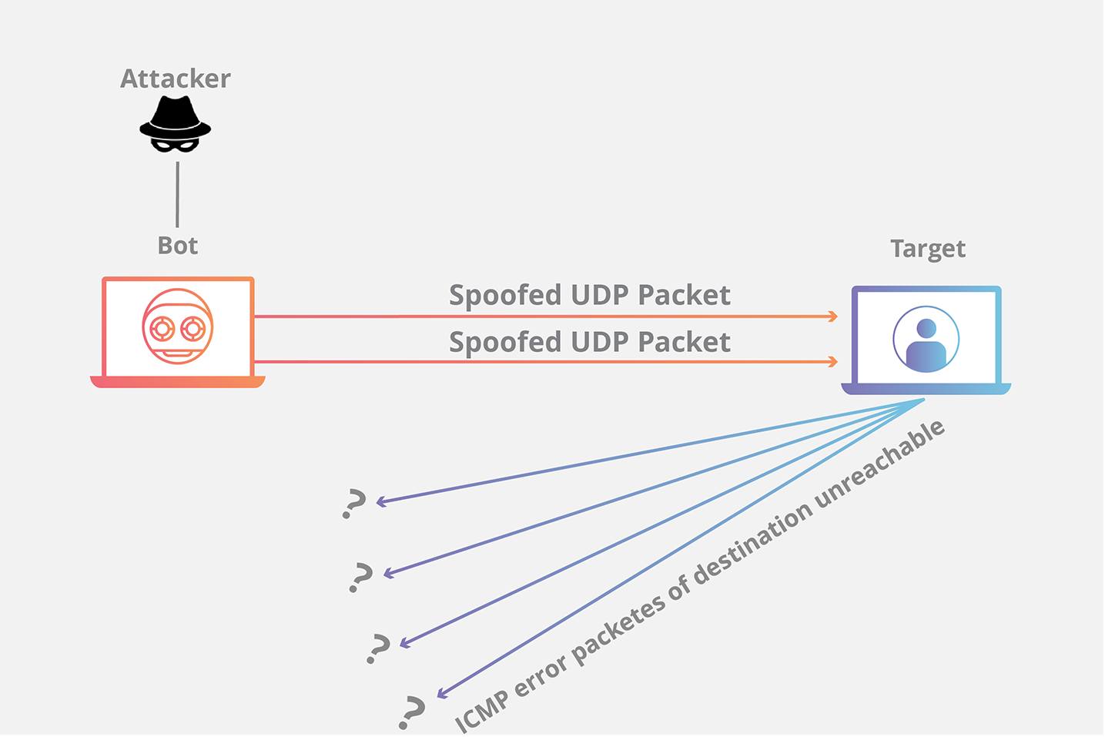
How does a UDP flood attack work?

Slide 25
What Makes UDP Floods Effective?
Stateless Protocol:
There is no built-in mechanism to limit or authenticate UDP packets, so the server processes each packet without verification.
Volume-Based: The attack relies on sheer volume to overwhelm the target.
Amplification: When combined with reflection and amplification (e.g., DNS or NTP amplification), the attack's impact can be magnified significantly.

Slide 26
Key Components Targeted in a UDP Flood ?
1. CPU Usage:
  The target system's CPU is consumed by the need to inspect and possibly respond to each packet.
2. Network Congestion:
  The network becomes saturated, preventing legitimate traffic.
3. ICMP Response Overload:
  If the server generates ICMP responses for packets sent to closed ports, it can further strain the system.

Slide 27
ICMP Flood Attacks: Deep Technical Analysis
A Comprehensive Study of ICMP-based DoS Attacks

Slide 28
What is ICMP?
Definition:
- ICMP (Internet Control Message Protocol) is a network layer protocol used for error reporting and diagnostic purposes (e.g., ping).
Characteristics:
- Part of the IP protocol suite.
- Stateless: Does not maintain connection states like TCP.
Common Types:
- Echo Request (Type 8) and Echo Reply (Type 0) for diagnostics.
- Destination Unreachable, Time Exceeded for error reporting.

Slide 29
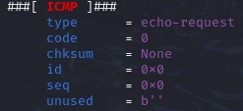
ICMP Packet Structure
Notes:
code = 0 : Champ toujours à 0 pour un Echo Request.
id = 0x0 : Identifiant pour associer le ping à sa réponse.
seq = 0x0 : Numéro de séquence pour suivre les paquets.
unused = b'' : Champ inutilisé, vide par défaut.

Slide 30
Comparison with TCP and UDP
ICMP:
  Stateless, no session establishment.
  Used for control and diagnostics.
UDP:
  Stateless, used for fast, connectionless communication.
  May trigger ICMP responses (e.g., Destination Unreachable).
TCP:
  Stateful, connection-oriented.
  Vulnerable to SYN Floods due to reliance on connection buffers.

Slide 31
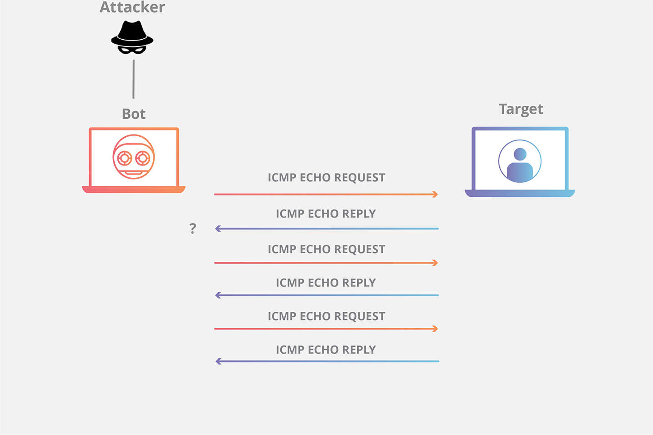
What is ICMP Flood (Ping flood)?

Slide 32
What is ICMP Flood (Ping flood)?
Definition:
A Denial-of-Service (DoS) attack where the attacker sends a large number of ICMP Echo Requests to overwhelm the target.
Attack Mechanism:
Overloads the target with requests.
Target responds with Echo Replies (if configured), consuming more resources.
Objective:
Exhaust CPU resources (processing requests).
Saturate network bandwidth.

Slide 33
Implementation
(Python and Scapy)

Slide 34
Comparison of Flood Attacks
Type | Targeted Resource | Mechanism
SYN Flood | TCP Buffer | Half-open connections fill TCP backlog.
UDP Flood | CPU, Bandwidth | Sends massive UDP packets to overwhelm system.
ICMP Flood | CPU, Bandwidth | Overloads target with ICMP Echo Requests.

Slide 35
Question
During an ICMP Flood attack, even if the server is overwhelmed by ICMP packets, what is the impact on other services? For example, if I try to connect to the server using HTTP over TCP, will it still work?

Slide 36
Countermeasures
Immediate Actions:
Rate-limit ICMP traffic.
Block unnecessary ICMP packets using firewalls.
Preventive Strategies:
Configure network devices to ignore Echo Requests from suspicious sources.
Implement anti-DDoS solutions.
Advanced Techniques:
Monitor traffic patterns for anomalies.
Use Access Control Lists (ACLs) with strict filtering rules.

Slide 37
the concept of
"Synonymous IP Attack“ ?

Slide 38
Synonymous IP Attack
The Synonymous IP Attack involves sending a large number of spoofed packets (SYN, UDP, ICMP, etc.) to a victim server using the victim’s own IP address or the same source/destination address for all packets.

